Slide 1
Data Science& Business Analytics
Internship at The Spark Foundation
CH.VAMSHI(4511-18-733-017)

Slide 2
Contents
Predictions using Supervised Machine Learning.
Prediction using Unsupervised Machine Learning.
Exploratory Data Analysis.
Prediction Using Decision Tree Algorithm.

Slide 3
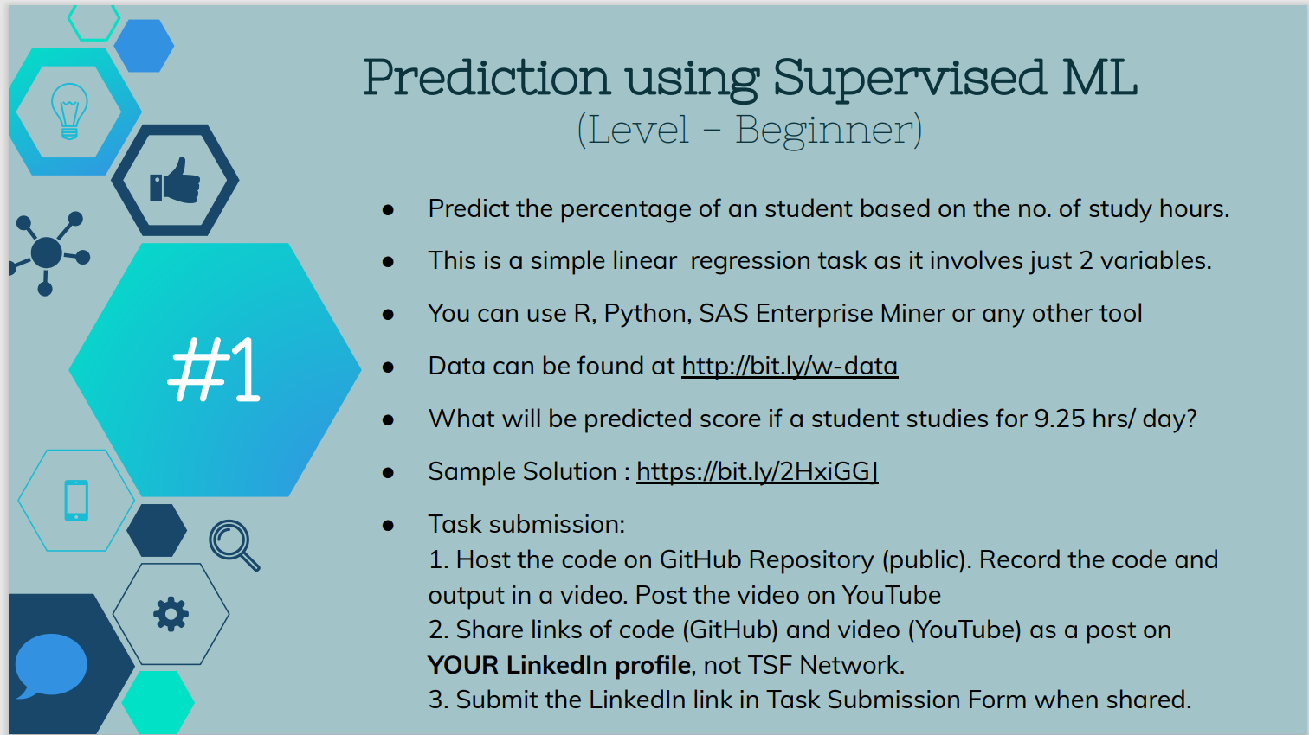

Slide 4


Slide 5
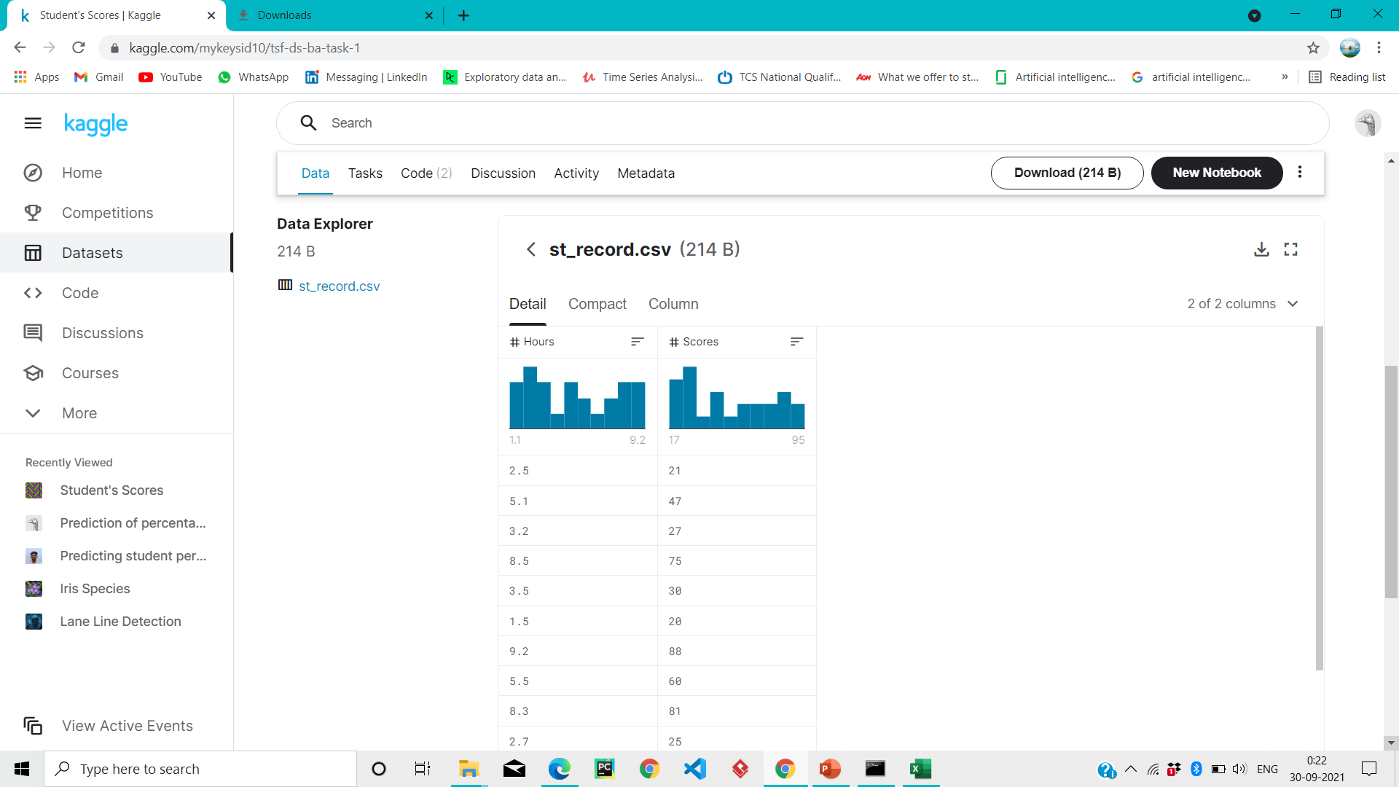

Slide 6
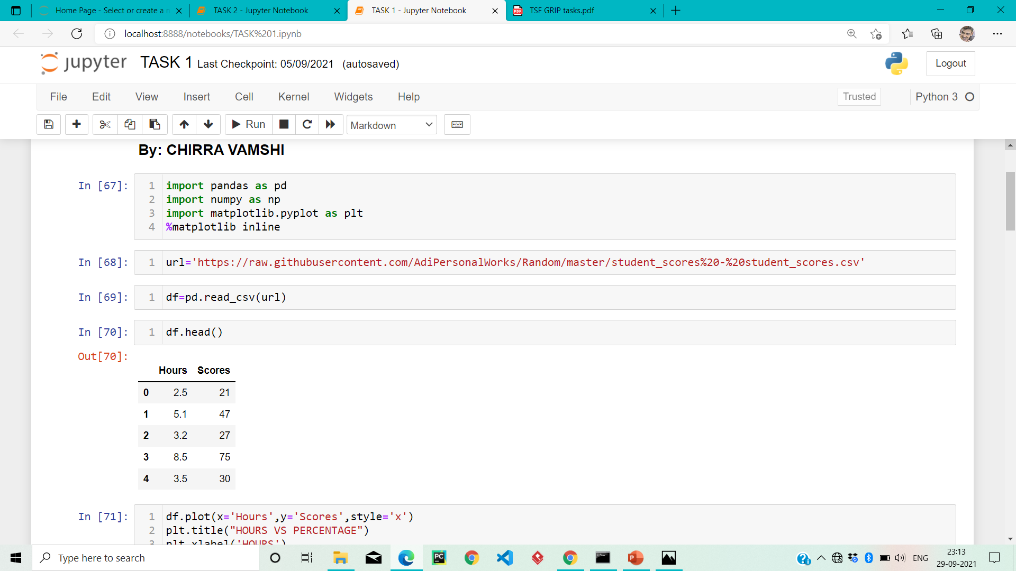

Slide 7
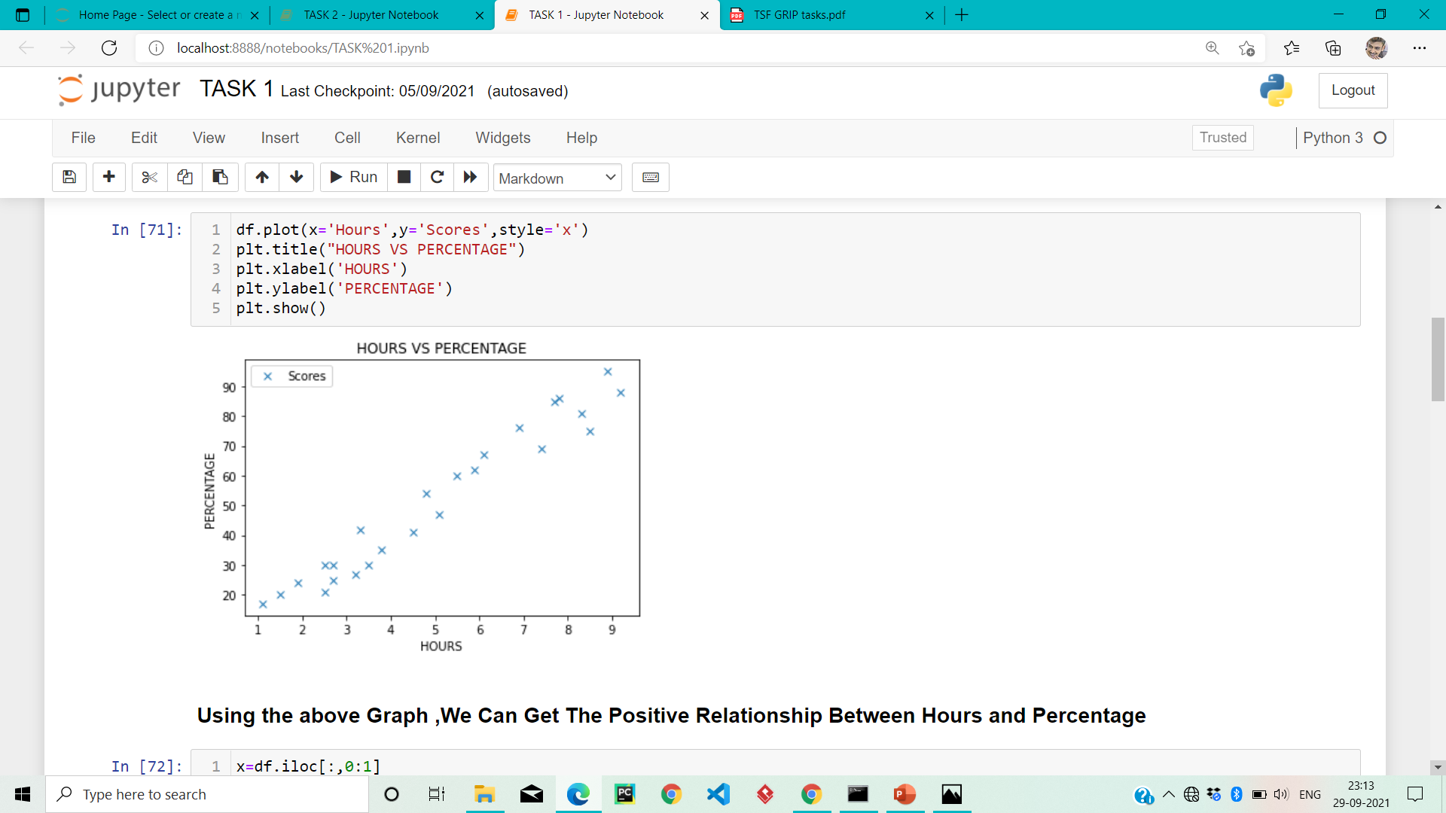

Slide 8
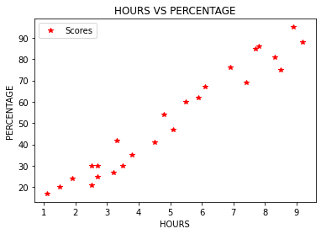

Slide 9
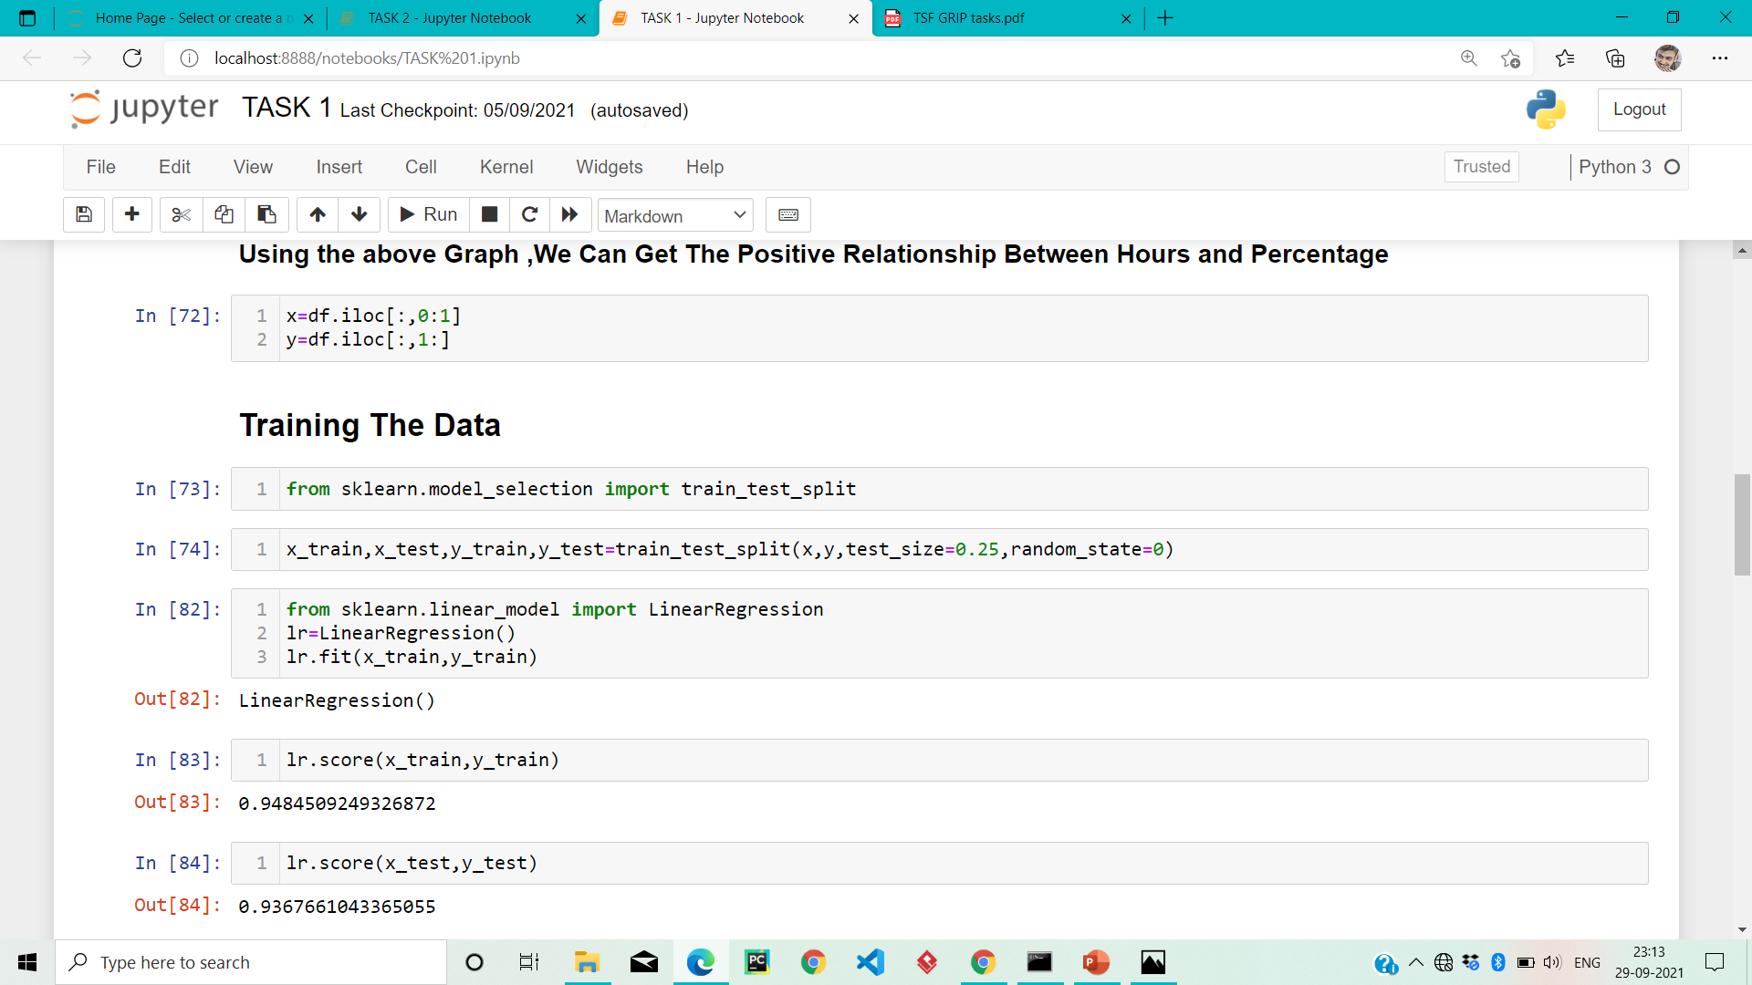

Slide 10
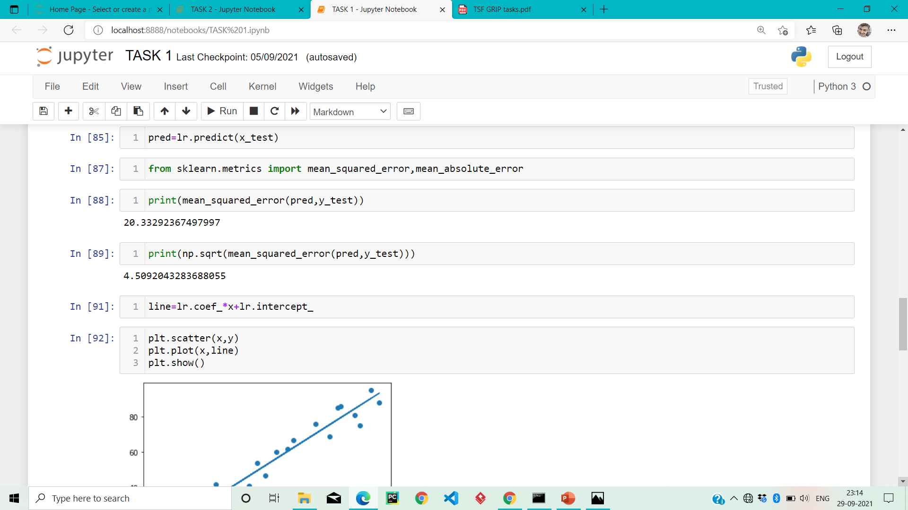

Slide 11
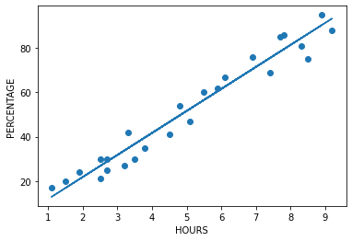

Slide 12
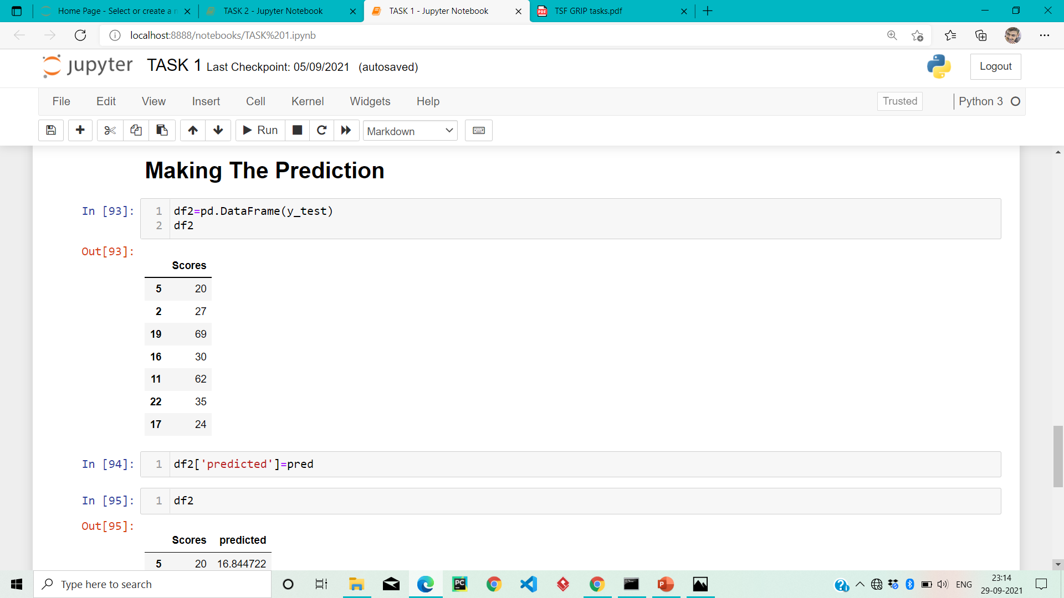

Slide 13
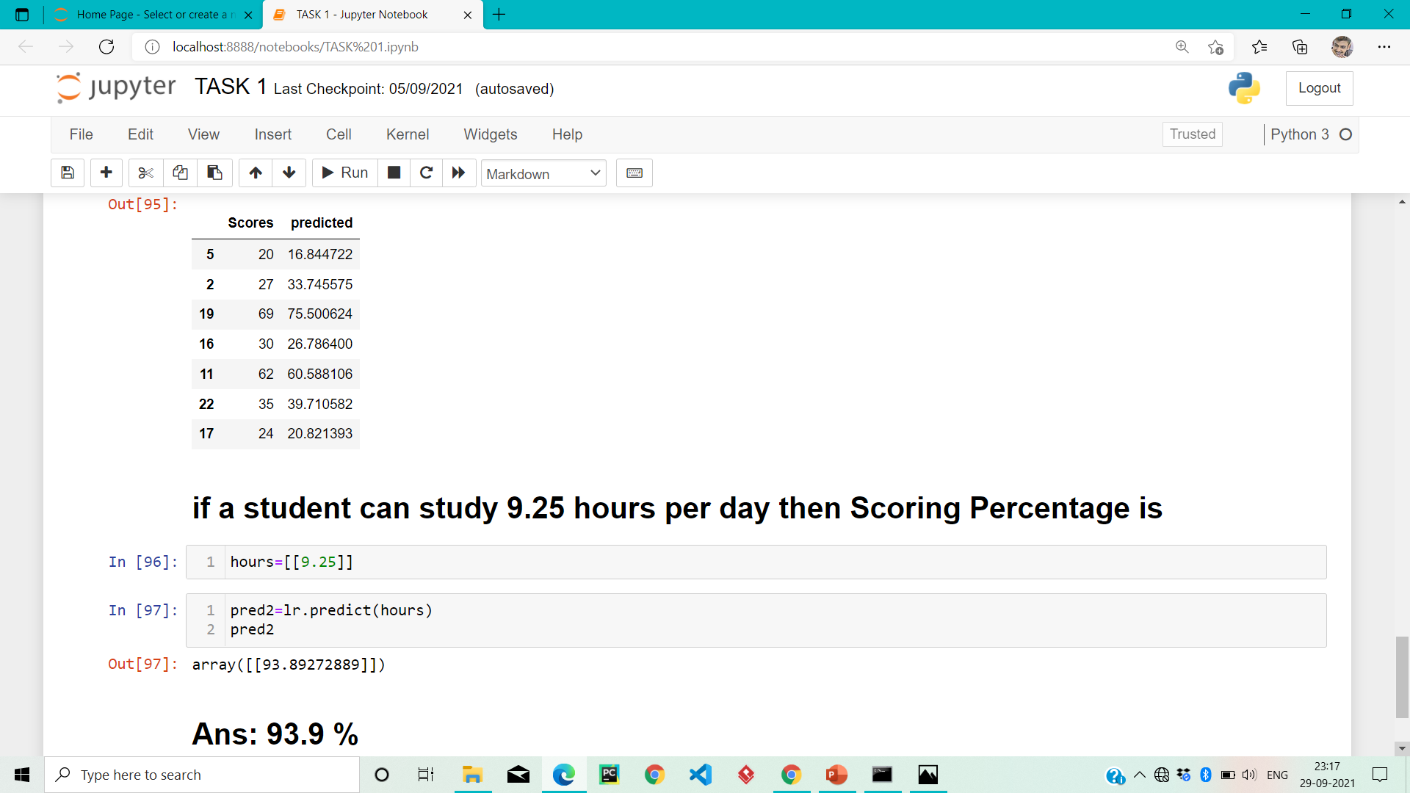

Slide 14
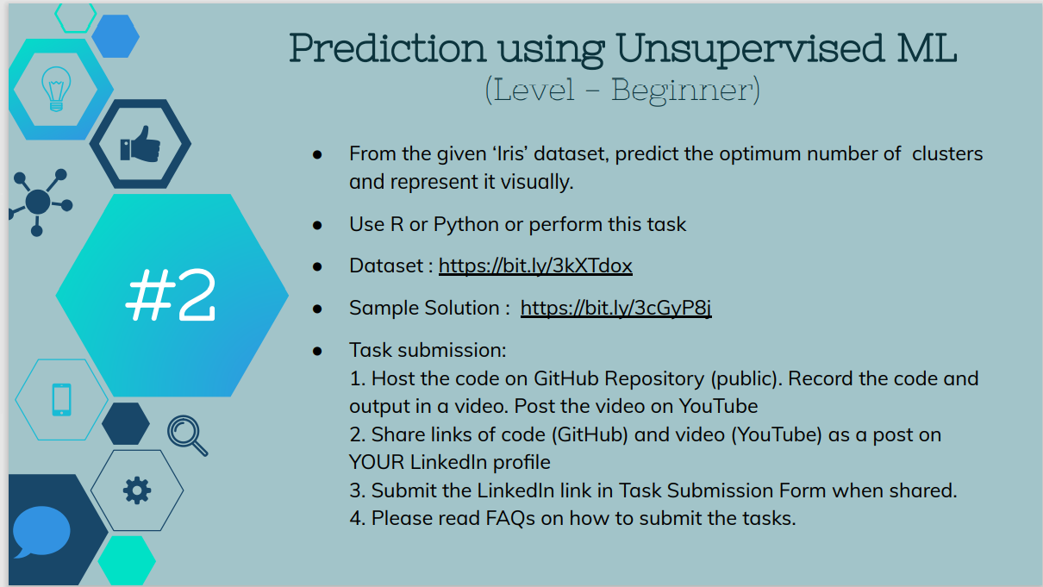

Slide 15


Slide 16
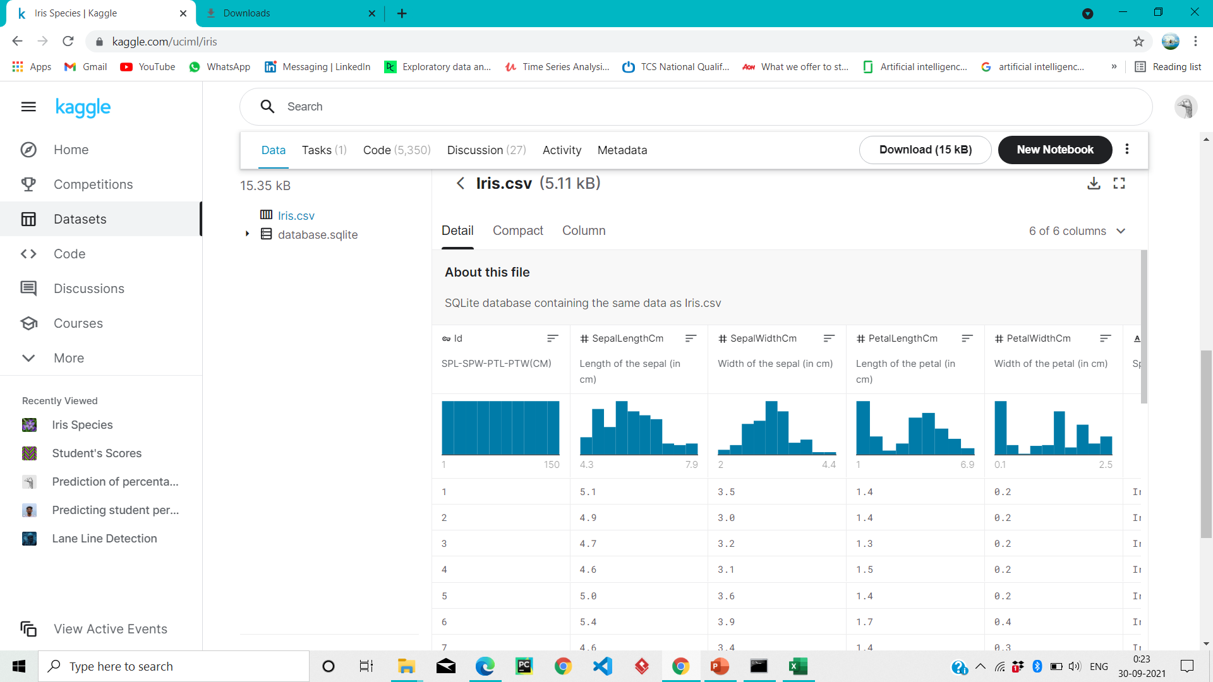

Slide 17
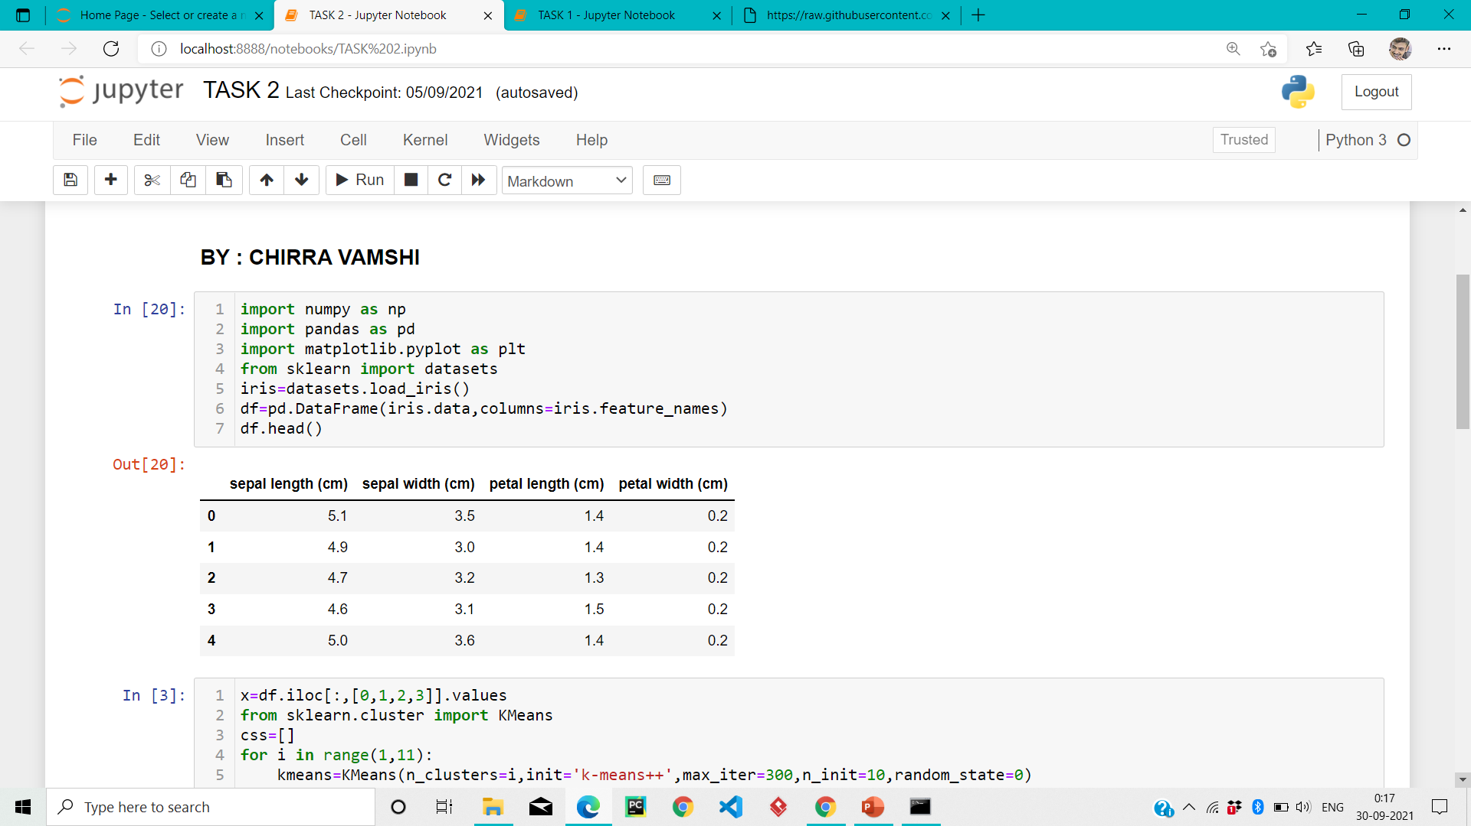

Slide 18
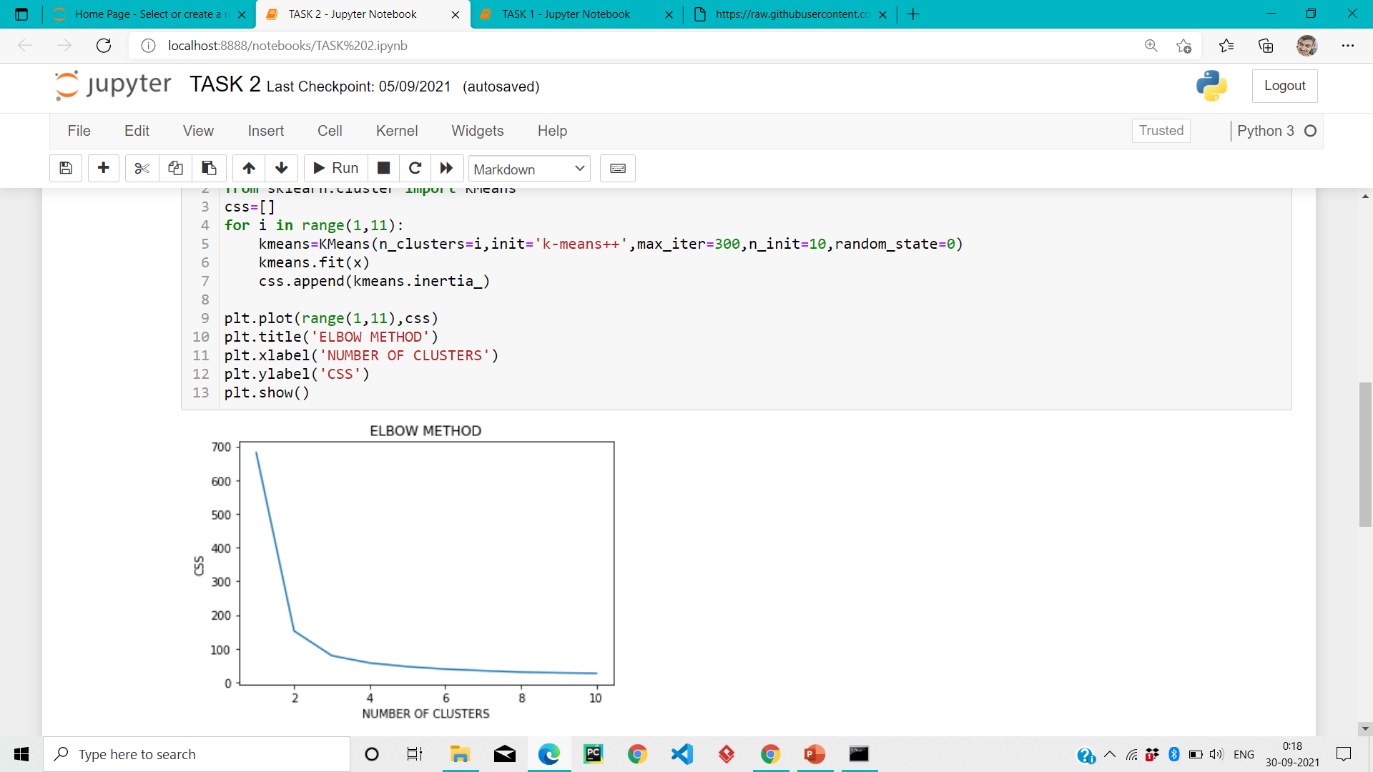

Slide 19
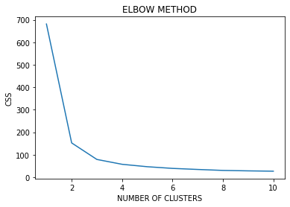

Slide 20
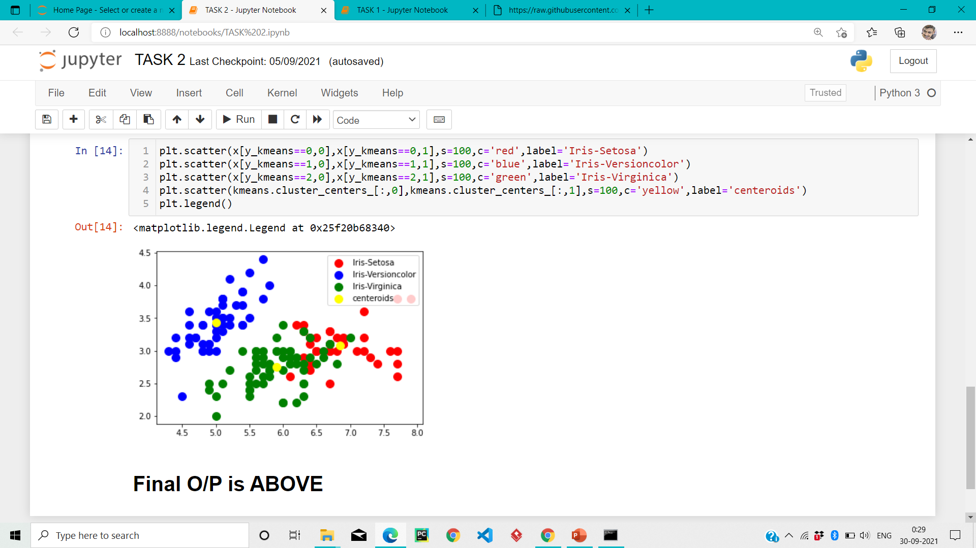

Slide 21
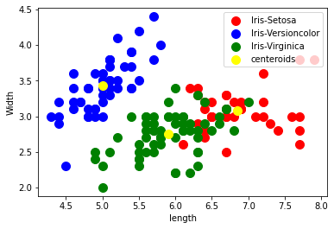

Slide 22
Thanks

Slide 23


Slide 24
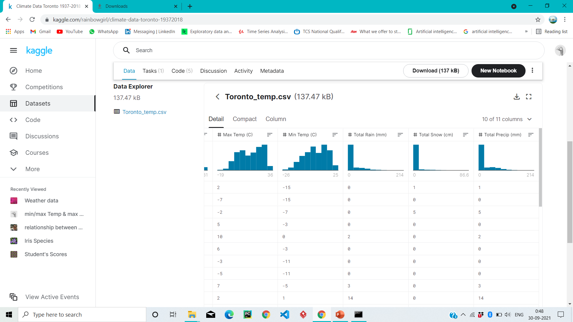

Slide 25
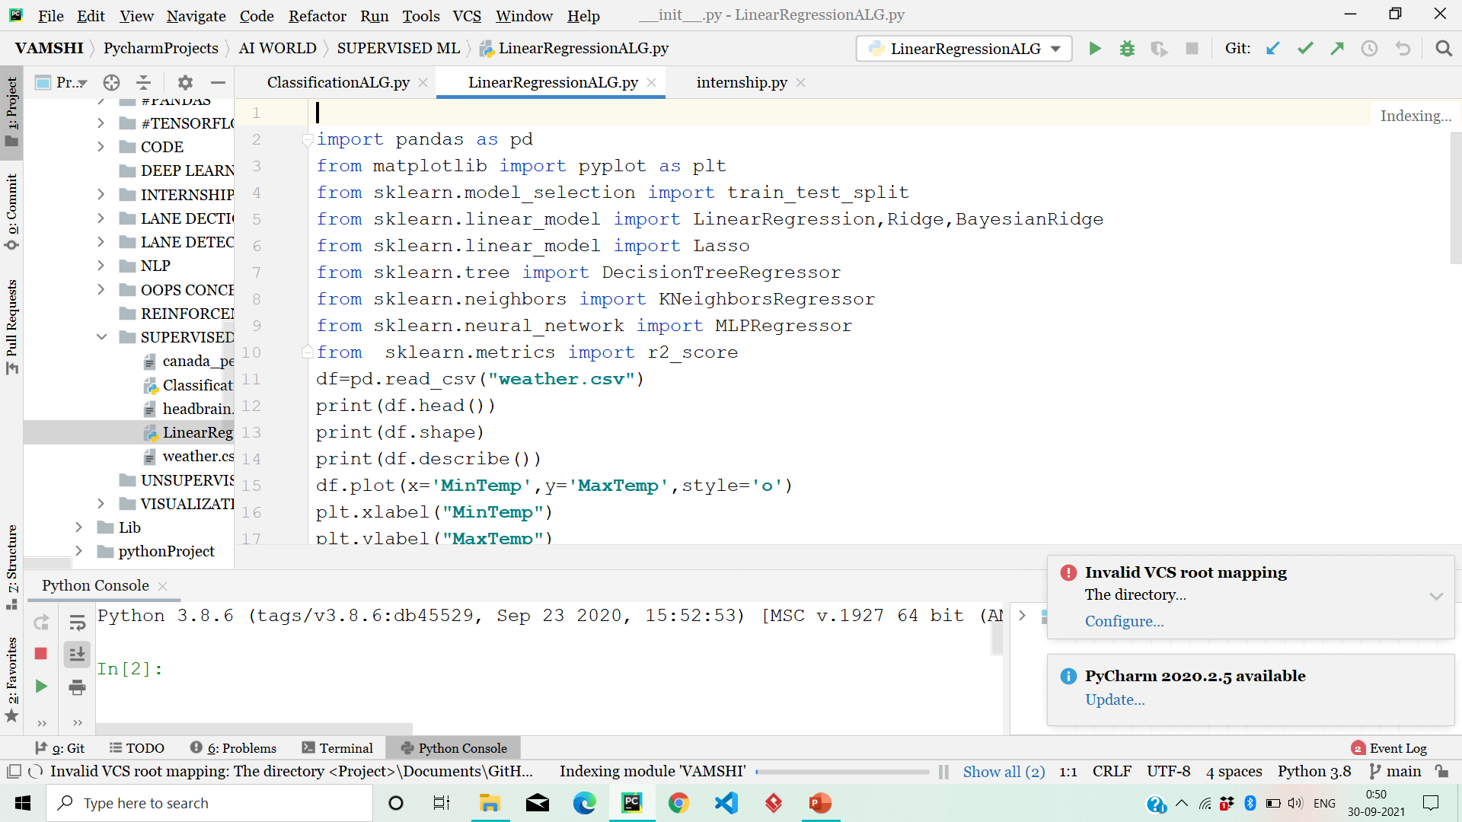

Slide 26
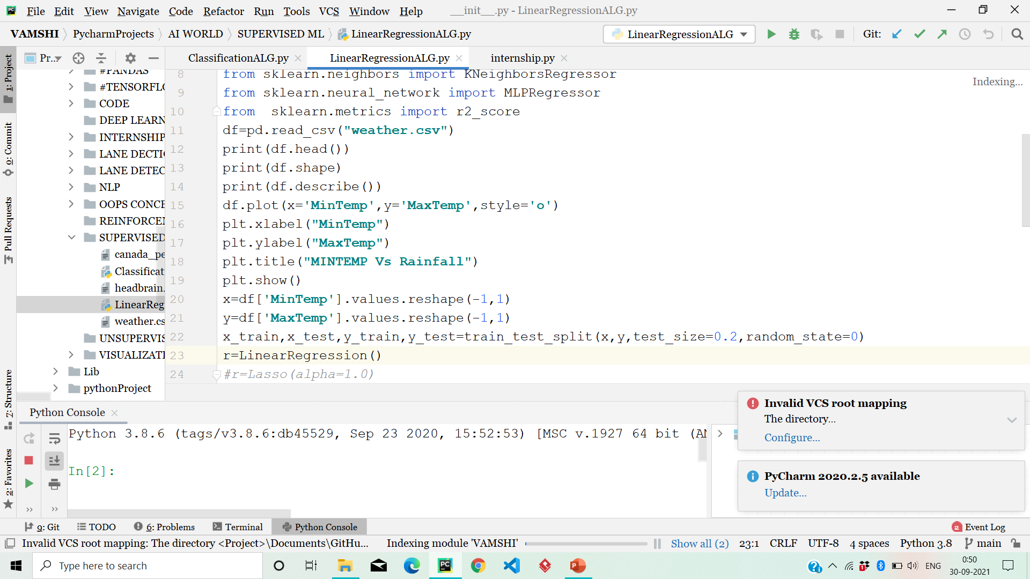

Slide 27
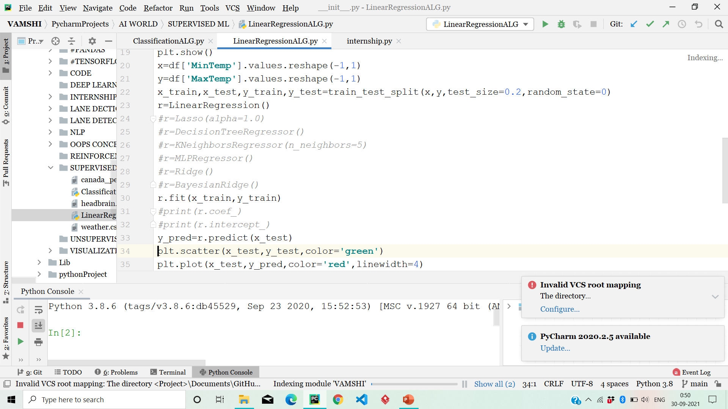

Slide 28
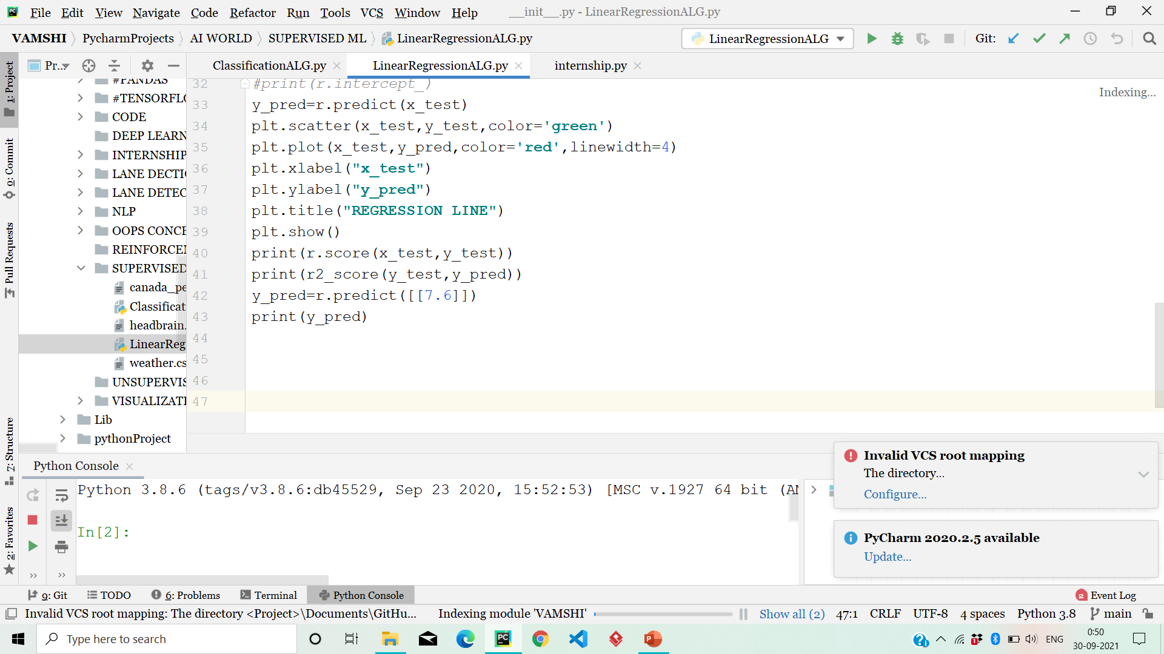

Slide 29
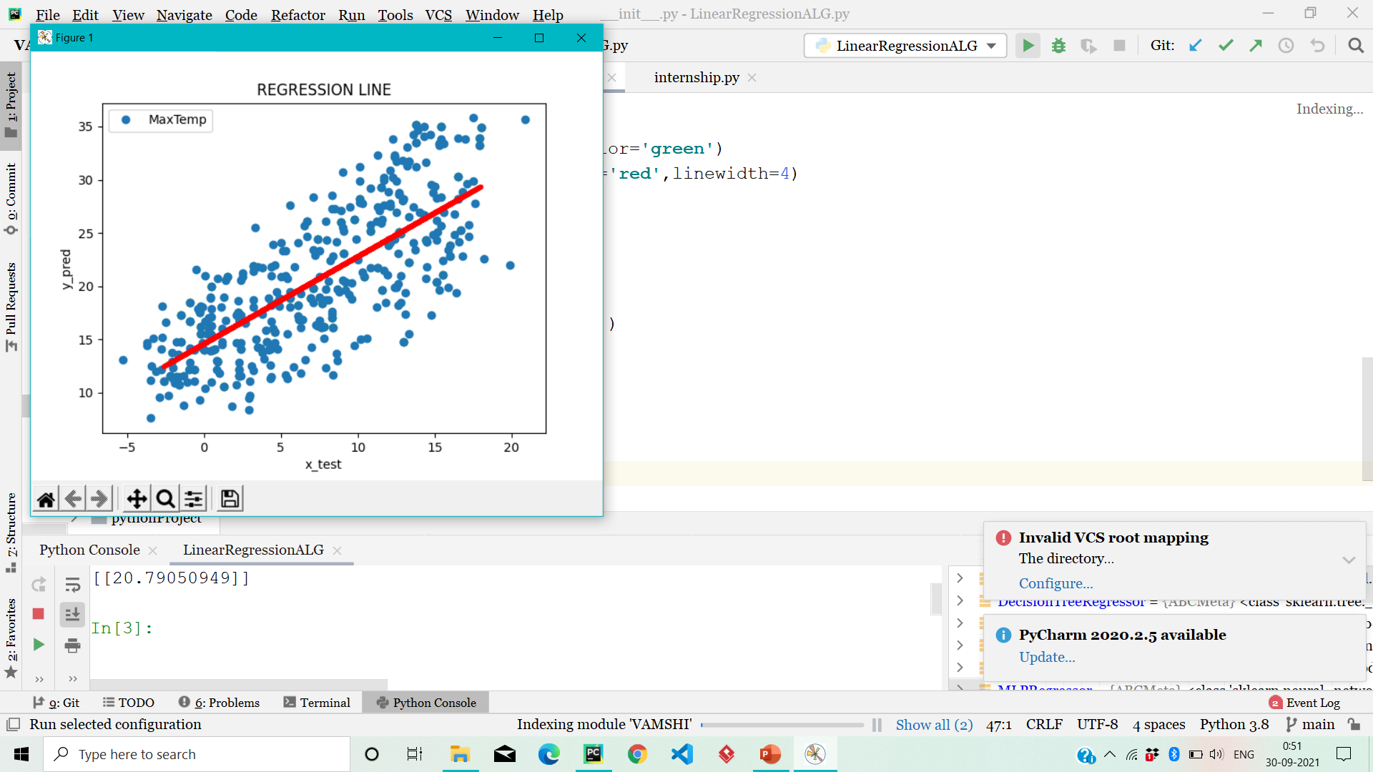

Slide 30
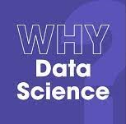
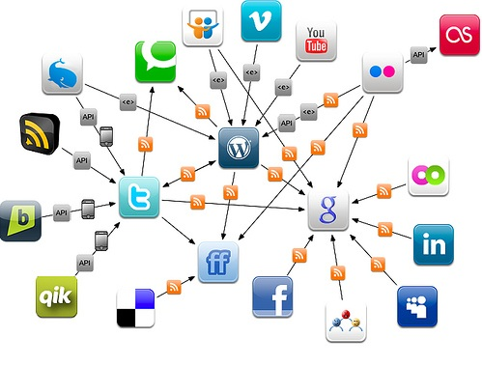
Introduction
In the past,we used to have data in structured format but now days the volume of the data is increasing, so there is massive amount of data is there but it is unstructured format.
To deal with that unstructured data we need data science techniques.
That data can be used to get the proper insights and hidden trends from them.
To define data science is Process of finding meaningfull information from massive amount of data.
Data Science is mixture of various tools and algorithms in machine learning to discover hidden patterns from unstructured data.

Slide 31
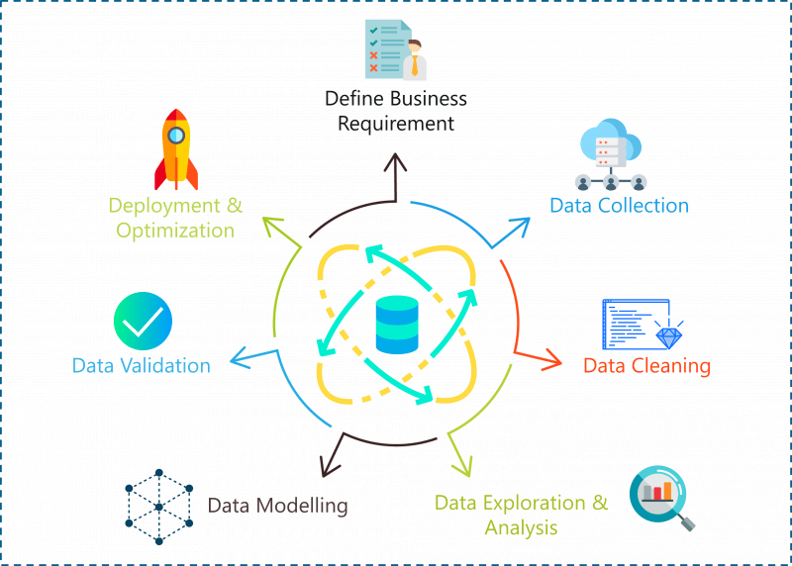
Data Science Life Cycle

Slide 32
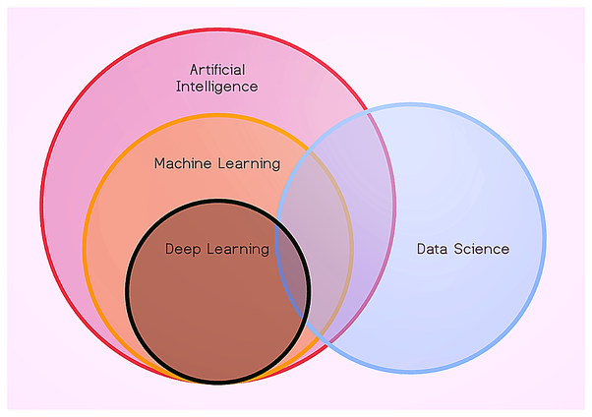
Relationship B/w Data Science and ML

Slide 33
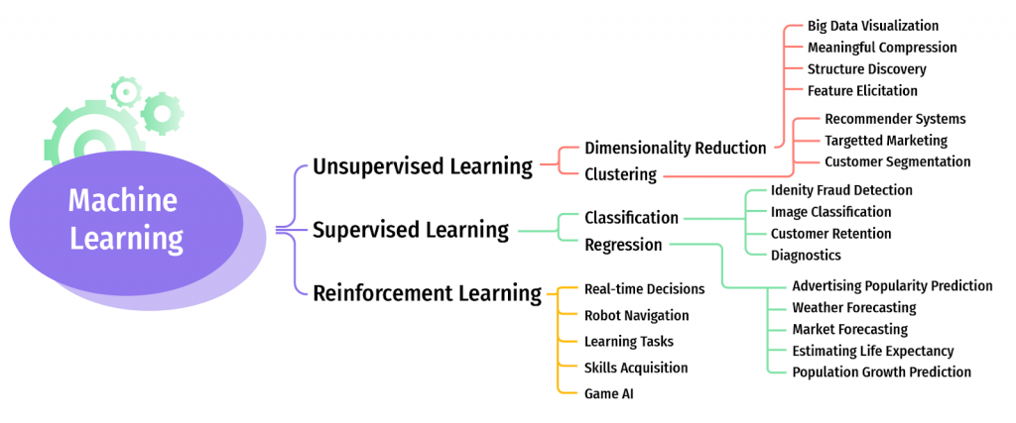
Machine Learning
“ It is field of study that gives Computers (or) Machines can Learn Without Being Explicity”- Author Somuel
(OR)
“ A Computer programm is said to learn from the Experience E with Respect to some task T, and Performance measure P,if it Performance at task in T as measured by P,improve the Experience E” – Tom Mitchell

Slide 34

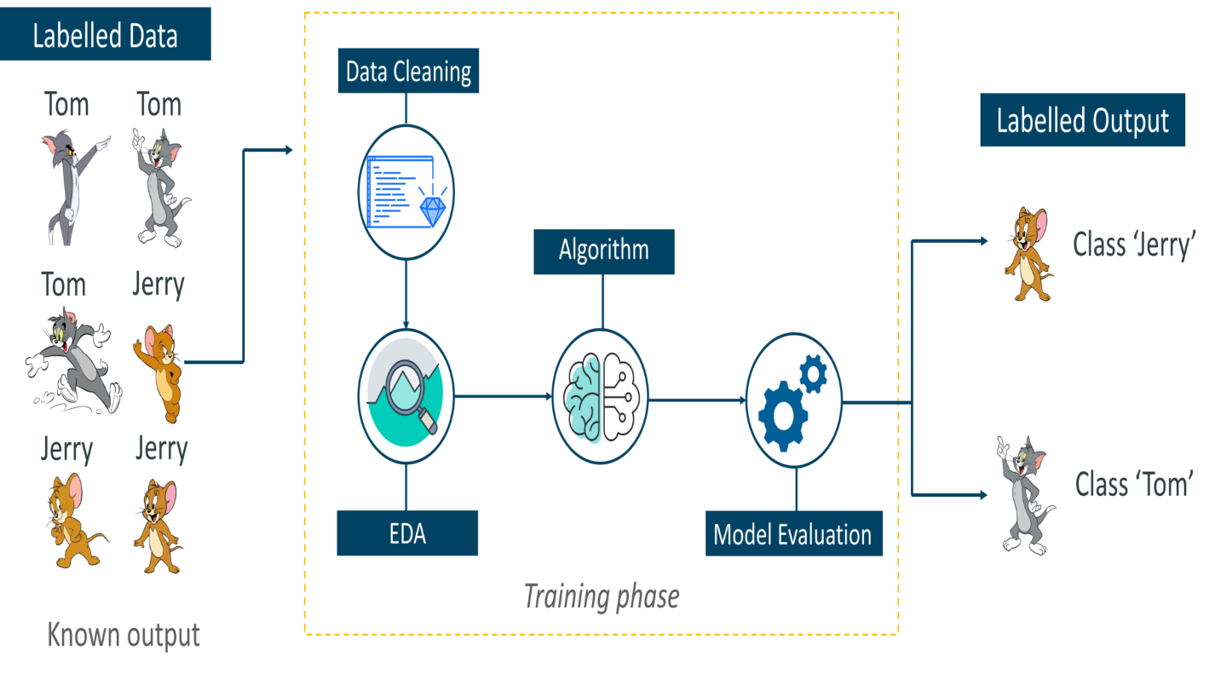
1.Prediction Using Supervised Machine Learning
Supervised Machine learning is one of the type of Machine Learning.
Supervised Machine Learning: when we are training a machine with Labeled data.After that we are giving new data, that machine can be predict by using training labeled data and Produce output.
Supervised Machine Learning Algorithms gives always correct answers.

Slide 35
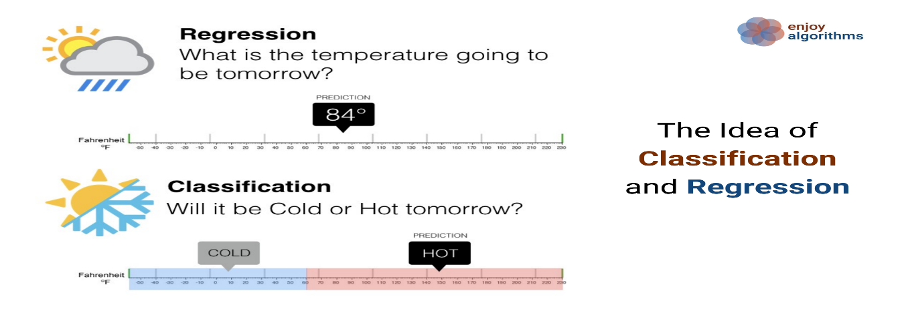
Types of Supervised Machine Learning:
There are Two types of supervised ML
1.Regression
2.Classifiaction
Regression:
It is used to find the Relationship between dependent variable and independent variable.
It is always gives the output in the form of Numerical Values (or) Continues Values.
Types of Regression:
1.Simple Linear Regression.
2.Multi Variable Regression.
Regression Algorithms:
1.Linear Regression Algorithm. 4.Ordinal Regression Algorithm.
2.Ploynomial Regression Algorithm. 5.Poission Regression Algorithm.
3.Lasso Regression Algorithm. 6.Bayesian Regression Algorithm.

Slide 36
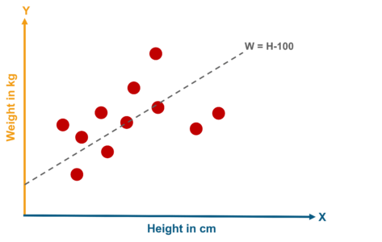
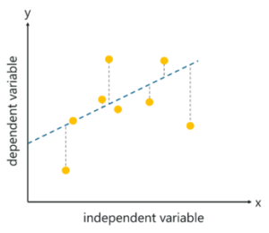
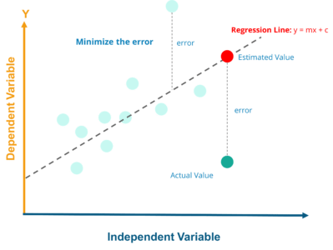
Regression

Slide 37

Classification:
It is the Process of categerizing data into different classes.
The Predicted output is always in the form of categorical (or) descreat data.
There are two types of classification.
1.Binary classification.
2.Multi classification.
Binary classification:
If the Given labelled data can be categerized into two classes is called Binary classification.
Muticlass classification:
If the given labelled data can be categerized into more than two classes is called Multiclass classification.
Classification Algorithms:
1.Navie Bayes.
2.Support Vector Machine.
3.Decision Trees.
4.Random Forest.
5.K-NN.
6.Logistic Regression.
7.Neural Networks.

Slide 38
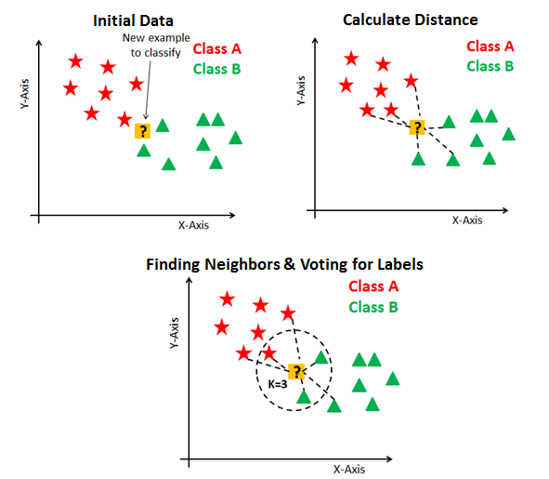
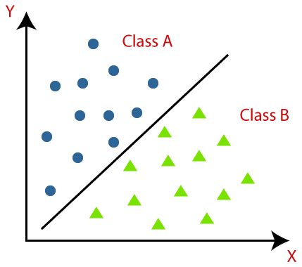
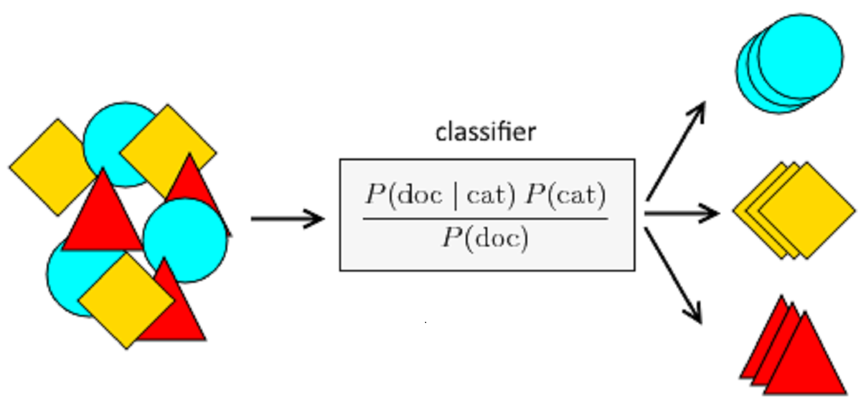
Classification:
NAIVE BAYES
SVM
KNN

Slide 39
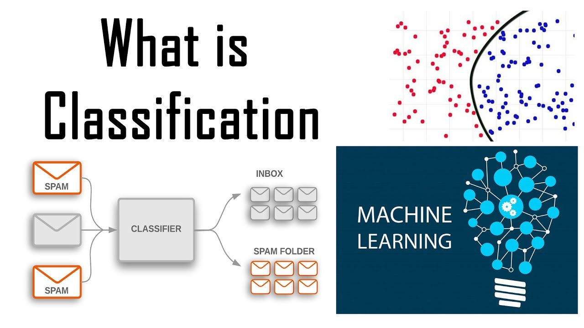
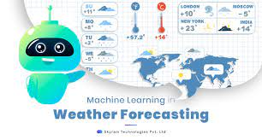


Applications of Supervised ML :
Spam Detection.
Speech Recognization.
Finger print sensor.
Text categorization.
Weather Forecasting.
Image classification.
House Price Prediction.

Slide 40

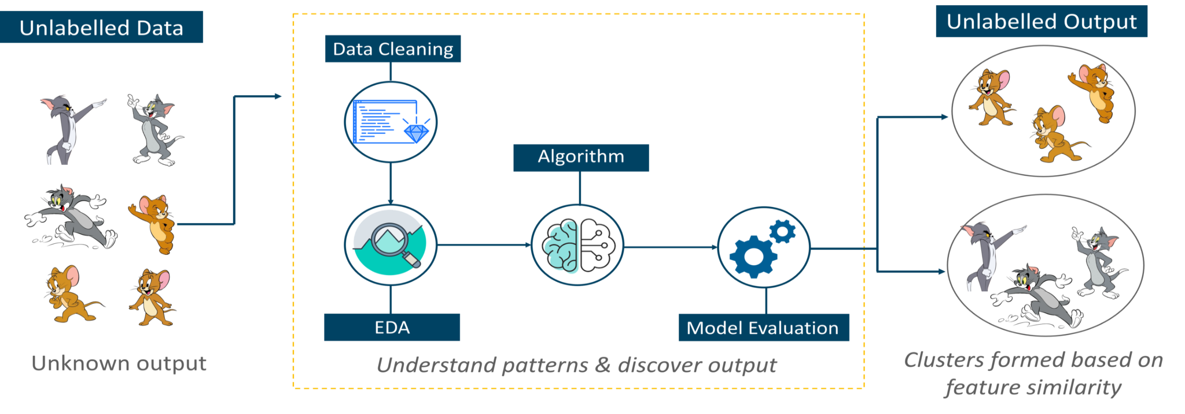
2.Prediction Using Unsupervised Machine Learning
Unsupervised is one of the type of Machine Leaning Type.
Unsupervised Machine Learning:when we are training a machine with unlabeled data.After that we are giving testing data,that machine can predict by using Pattern based ,insight characteristics of data and Produce Output.
It always predictions are not correct,it some times predict wrong also.

Slide 41
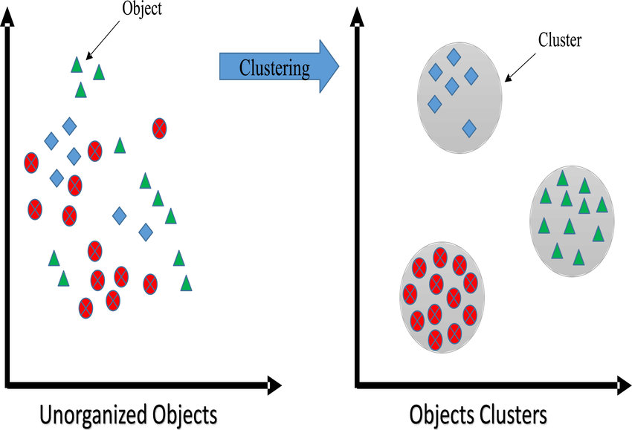
Types of Unsupervised Machine Leaning:
There are Main types of Unsupervised ML:
1.Clustering.
2.Dimensionality Reduction. 3. Association.
Clustering:
A Group of objects that are similar together basis on their characteristics, Objects in one cluster is dissimilar to in that other cluster data points.

Slide 42
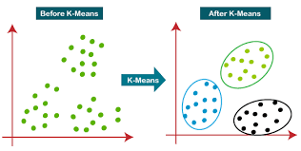
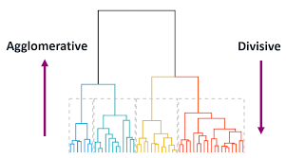
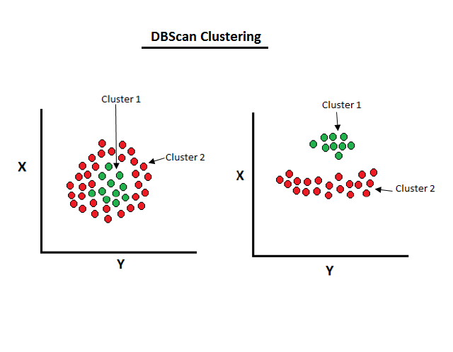
There are three types of clustering is there.
1.Partail clustering.
i.Hard clustering.
ii.Soft clustering.
2.Hierarchial clustering.
i.Buttom to Top Hierachial clustering.
ii.Top to Buttom Hierachial clustering.
3.Density Based clustering.
Clustering Algorithms:
1.K-means clutering.
2.Fuzzy c-means clustering.
3.Agglomerative clustering.
4.Divise clustering.
5.DBSCAN clustering.

Slide 43
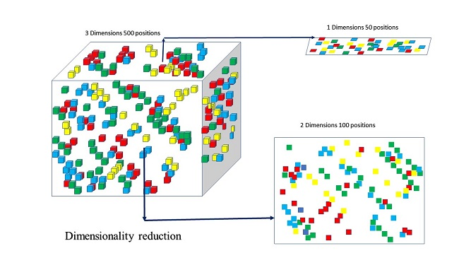
Dimensionality Reduction:
The higher the number of features, the harder it gets to visualize the training set and then work on it.
Sometimes, most of these features are correlated, and hence redundant.
This is where dimensionality reduction algorithms come into play.
Dimensionality reduction is the process of reducing some unwanted Features and that features not effect on the final Output.
Feature Selection.
Feature Extraction.
Dimensionality Reduction Algorithms:
1.Principle of Component Analysis.
2.Linear Descriminent Analysis.

Slide 44
Association:
Association rule learning is a type of unsupervised learning technique that checks for the dependency of one data item on another data item and maps accordingly so that it can be more profitable.
It tries to find some interesting relations or associations among the variables of dataset.
It is based on different rules to discover the interesting relations between variables in the database.
It is used in different areas ,mainly in market basket analysis.
We can understand it by taking an example of a supermarket, as in a supermarket, all products that are purchased together are put together.
For example, if a customer buys bread, he most likely can also buy butter, eggs, or milk, so these products are stored within a shelf or mostly nearby.

Slide 45

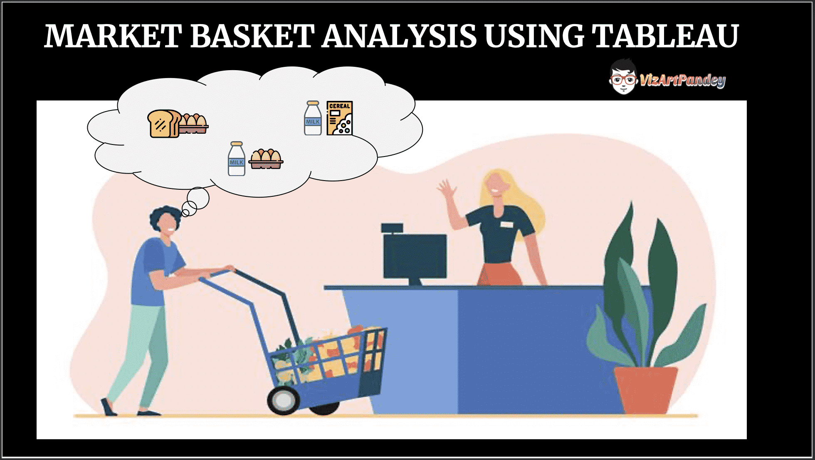
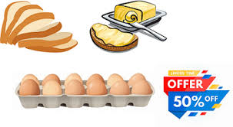

Slide 46
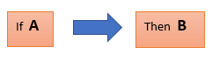
Association Rule:
Association rule learning works on the concept of If and Else Statement, if A then B.
These types of relationships where we can find out some association or relation between two items is known as single cardinality.
It is all about creating rules, and if the number of items increases, then cardinality also increases accordingly.
So, to measure the associations between thousands of data items, there are several metrics. These metrics are given below:

Slide 47
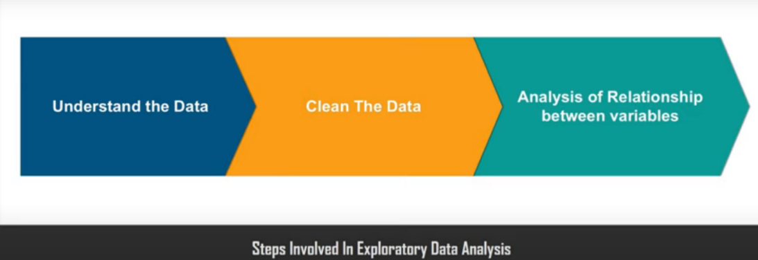
3.Exploratory Data Analysis
Exploratory Data Analysis (or) EDA is nothing but a data exploration technique to understand the various aspects of the data.
It is basically used to filter the data from redundancies.
Steps in EDA: 1.Understand the Data.
2.Clean Data.
3.Analysis of relationship between variables.

Slide 48
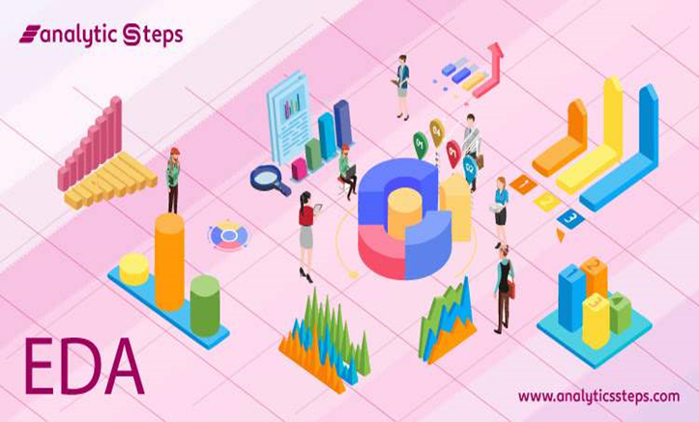
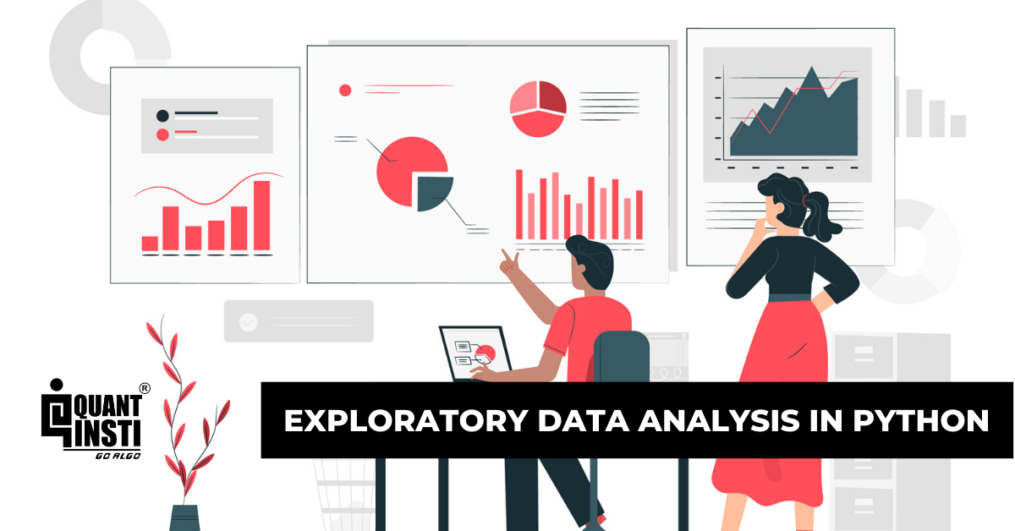
EDA

Slide 49


There are three primary types of EDA:
Univariate :
This shows every observation/distribution in data on a single data variable. It can be
shown with the help of various plots like Scatter Plot, Line Plot,Histrograms.
Bivariate :
Bivariate analysis displays are done to reveal the relationship between two data variables.
It can also be shown with the help of Scatter plots, histograms, Heat Maps, Box Plots.
Multivariate :
Multivariate analysis, as the name suggests,displays are done to reveal the relationship between more than two data variables.

Slide 50

4.Prediction Using Decision Trees
Decision tree:It is a graphical representation of all the possible solutions to decision based on certain coditions.
Here the root node having entire data set information.
It is Supervised machine learning algorithm, but it can work both Regression and classification Problems.
The leaf nodes can having final results and internal nodes can take decision making information.
In building Decision tree the major challenge is creating Decision nodes.It can possible in two ways.we
We want split the decision is best to split to divide the information.
1.CART Algorithm.
2.ID3 Algorithm.

Slide 51
ID3 Algorithm:
It mainly Working based on the Information Gain.
Information Gain(IG):
Information Gain is the decrease/increase in Entropy value when the node is split.
An attribute should have the highest information gain to be selected for splitting.
Based on the computed values of Entropy and Information Gain, we choose the best
Attribute for split.
Entropy:
It is measurement of degree of Randomness of information.
E=-P(yes)log2P(yes)-P(no)log2P(no)
I.G=E-[w*E(for each attribute)]

Slide 52


CART Algorithm:
It is mainly Working based on Gini Index.
CART full form is Classification & Regression Trees Algorithm.
Gini Index(GI):
Gini Index is a metric to measure how often a randomly chosen element would be incorrectly identified.
It means an attribute with lower Gini index should be preferred.
The Formula for the calculation of the of the Gini Index is given below.

Slide 53

Thanks

